Slide 1
CS322 MINI PROJECT
EXTENDING MARS FUNCTIONALITY
KHUSHI PRASAD 2001CS38

Slide 2
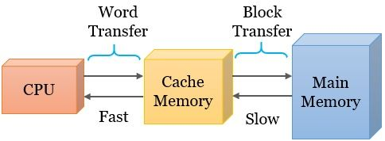
CACHE : INTRODUCTION
- A cache is a storage component that stores data so that future data requests can be served faster.
- It basically makes use of principle of locality of access. There are two types of locality access: 1. Temporal Locality 2. Spatial Locality
- Data Mapping between main memory and cache is of following three types: 1. Direct Mapping 2. Set-Associative Mapping 3. Fully Associative Mapping - Cache bridges the speed gap between the processor and the main memory. The yare usually found on the processor chip. - The storage of cache is limited. Block Replacement policies are used to determine which block is to be replaced in case the cache is full.

Slide 3
BLOCK REPLACEMENT POLICIES
When a Cache Miss occurs, to accommodate the requested block one of the blocks in cache need to be replaced.
In a fully associative cache, all the blocks are candidates for replacement.
The block to be replaced is decided by one of the “Block Replacement Algorithms”. Some of the mentioned replacement policies are: - LRU -FIFO -LFU -LRU 2 - RANDOM

Slide 4
BLOCK REPLACEMENT POLICIES (ALREADY IN MARS)
LEAST RECENTLY USED
This algorithm replaces the block that has not been used for the longest period of time. It is based on the observation that blocks that have not been used for long time will probably remain unused for the longest time and thus, is replaced.
RANDOM
It replaces a random page in memory.

Slide 5
BLOCK REPLACEMENT POLICIES (ADDED TO MARS)
LEAST FREQUENTLY USED
This algorithm replaces the block that has been accessed the least number of times.
FIRST IN FIRST OUT
In this algorithm, the oldest block, which has spent the longest time in memory is chosen and replaced.
LEAST RECENTLY USED - 2
In this, instead of the most recent access time, we compare the second most recent access time of the block.

Slide 6
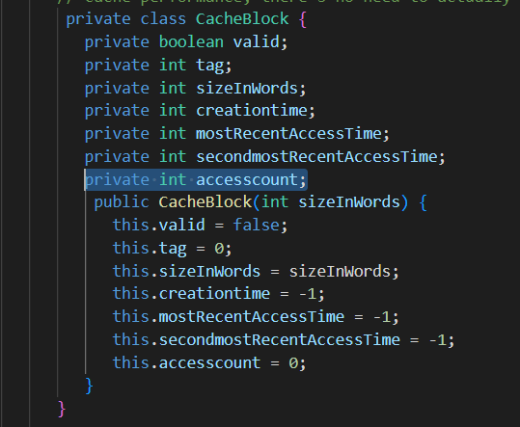
LEAST FREQUENTLY USED - IMPLEMENTATION
Defined 2 new variables:
accesscount -> one to keep track on number of times the respective block has been accessed.
leastAccesscount -> one to keep track of the global minima.

Slide 7
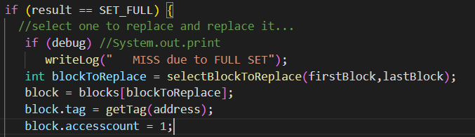
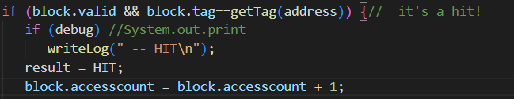
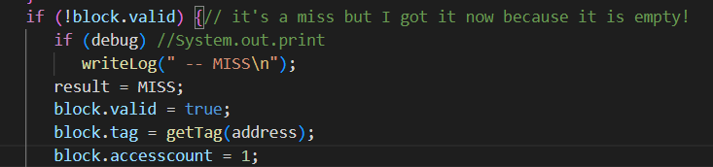
LEAST FREQUENTLY USED - IMPLEMENTATION
We initialise the variable <accesscount> whenever the respective memory block is accessed.

Slide 8
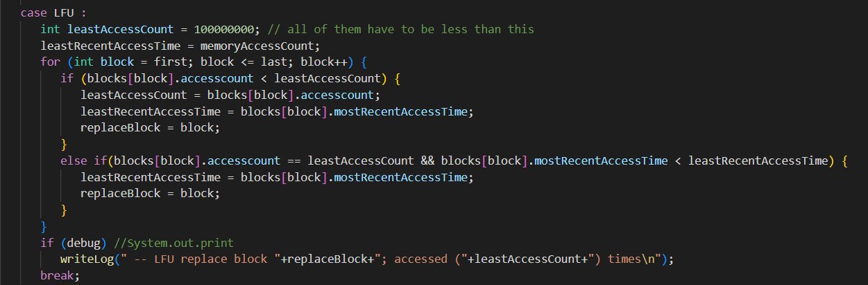
LEAST FREQUENTLY USED - IMPLEMENTATION
In case of full set,
We iterate over all the blocks updating <leastAccesscount> and storing the respective block.
At the end of the loop, the block that has been accessed least number of time is replaced.

Slide 9
FIRST IN FIRST OUT - IMPLEMENTATION
Define 2 new variables:
creationtime -> to store the time when the blocks were first used.
leastRecentCreationtime -> to store the least creation time.

Slide 10
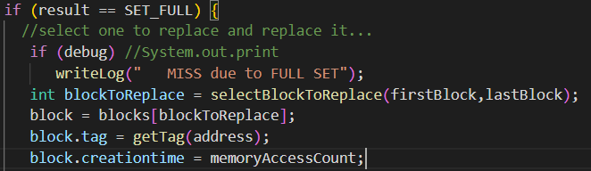
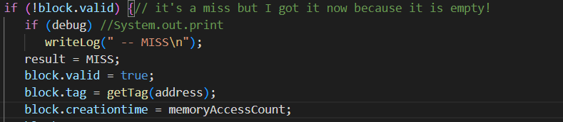
FIRST IN FIRST OUT - IMPLEMENTATION
We initialise the variable <creationtime> whenever the respective memory block is accessed.

Slide 11
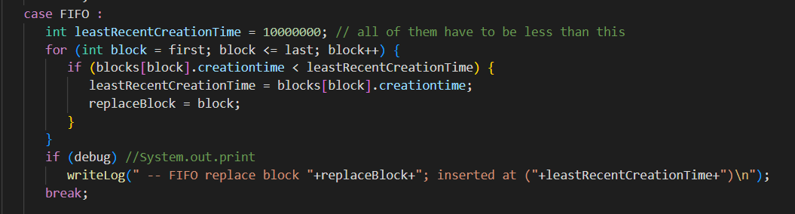
FIRST IN FIRST OUT - IMPLEMENTATION
In case of full set,
We iterate over all the blocks updating <leastRecentCreationtime> and storing the respective block.
At the end of the loop, the block that has been accessed the earliest is replaced.

Slide 12
LEAST RECENTLY USED 2 - IMPLEMENTATION
Define 2 new variables:
secondmostRecentAccesstime -> to store the time when the blocks were used second most recent time.
leastRecentsecondAccessTime -> to store the least second most access time of all the blocks.

Slide 13
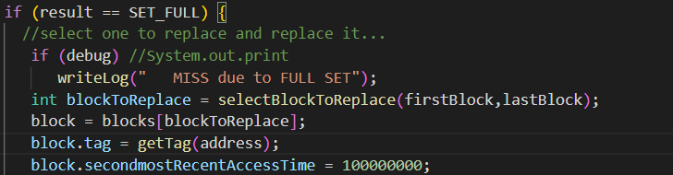
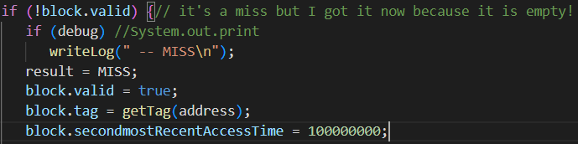
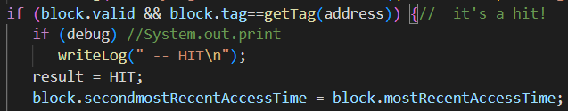
LEAST RECENTLY USED 2 - IMPLEMENTATION
We initialise the variable <secondmostRecentAccesstime> whenever the respective memory block is accessed.

Slide 14
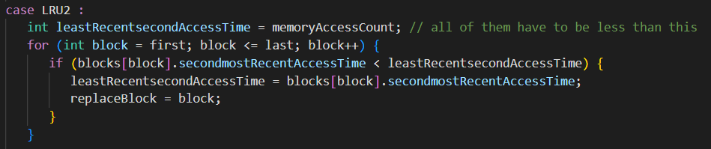
LEAST RECENTLY USED 2 - IMPLEMENTATION
In case of full set,
We iterate over all the blocks updating <leastRecentsecondAccessTime> and storing the respective block.
At the end of the loop, the block with the least second most recent access time is replaced.

Slide 15
PERFORMANCE
COMPARISON
For the performance comparison and analysis, following assumptions have been taken:
Access type is Fully Associative Mapping
No of blocks in cache = 4
No of words in a block = 2

Slide 16
MIPS PROGRAMS USED:
FIBONACCI SEQUENCE:
In this sequence, each kth number (k>=2) is the sum of preceding two numbers.
F(n) = F(n-1) + F(n-2)
where, F(n) represents the nth fibonacci number n>=2 F(0) = 0, F(1) = 1
FACTORIAL OF A NUMBER
Factorial of a number n is the product of all numbers from 1 to n.
Fac(n) = 1*2*3*4*....*n
where, Fac(n) is the factorial of the nth number Also, Fac(0) = 1

Slide 17
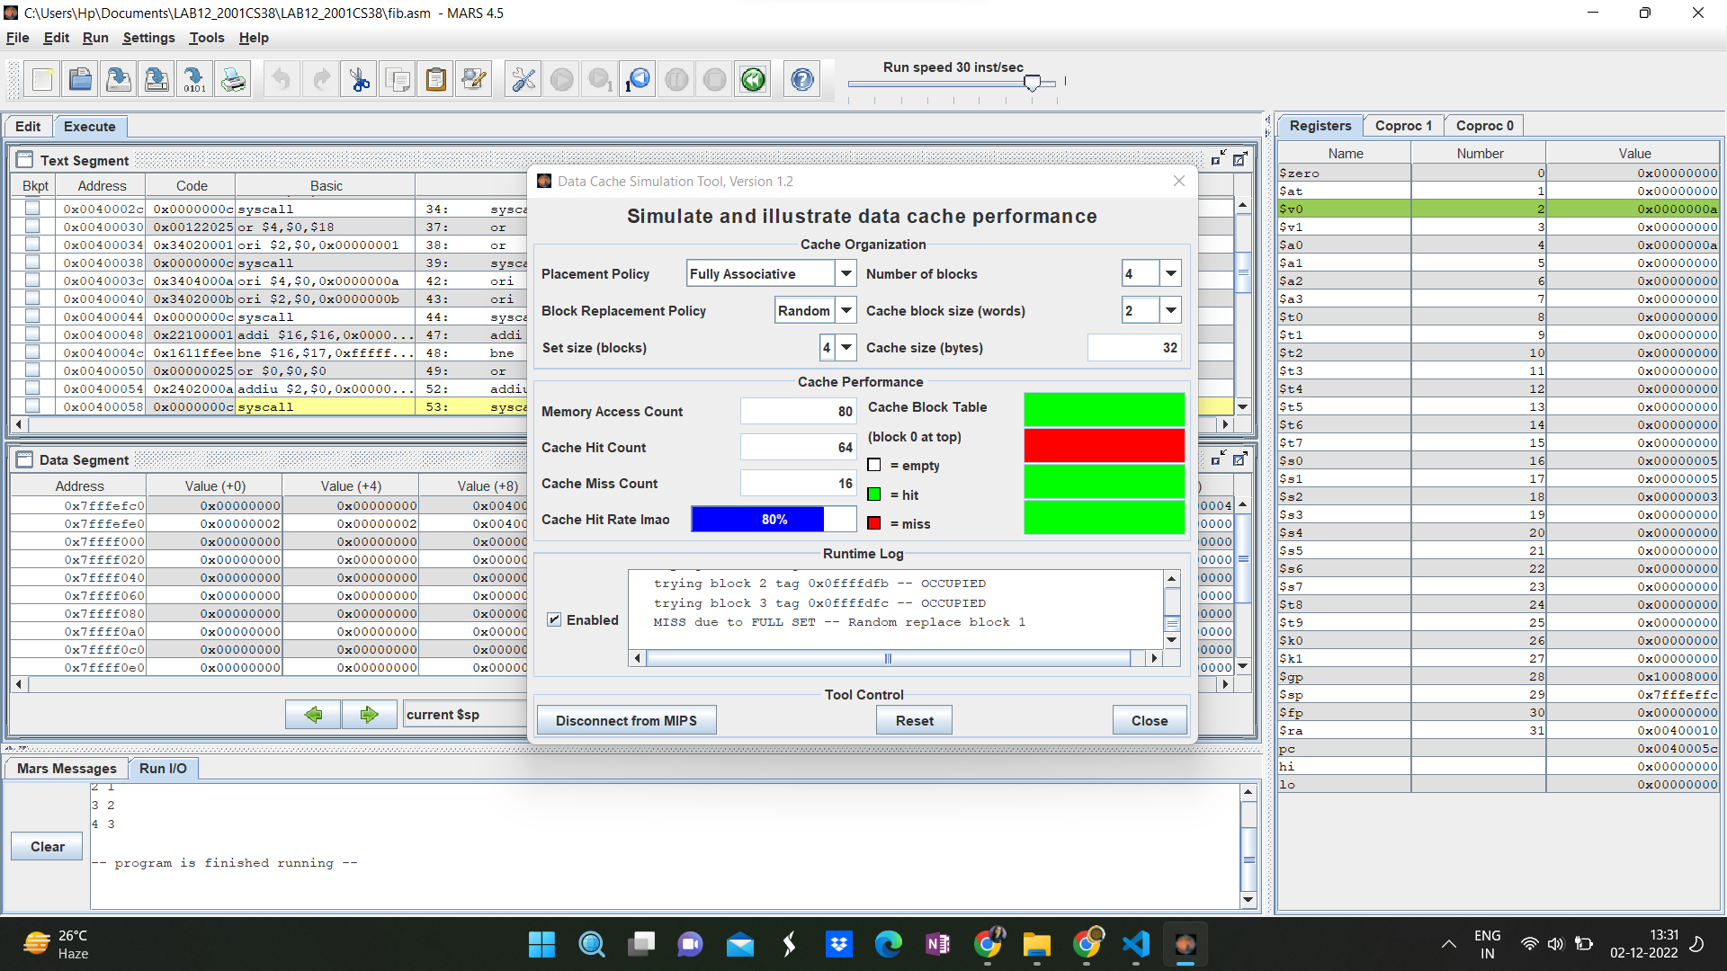
FIBONACCI, RANDOM REPLACEMENT POLICY, CACHE HIT RATE = 80%

Slide 18
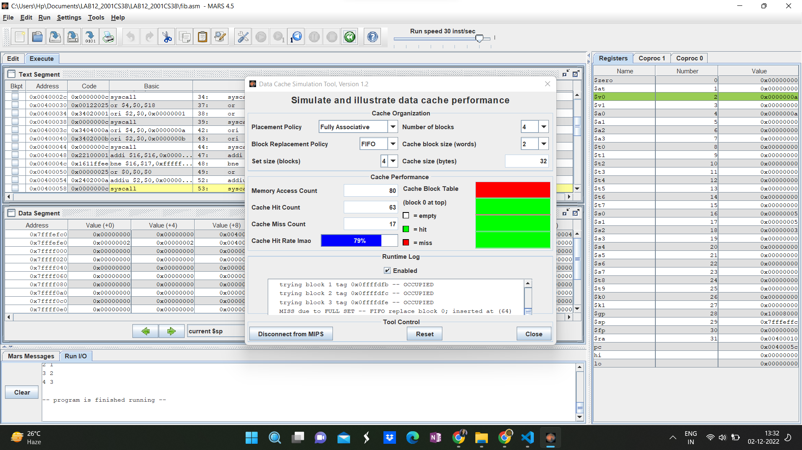
FIBONACCI, FIFO REPLACEMENT POLICY, CACHE HIT RATE = 75%

Slide 19
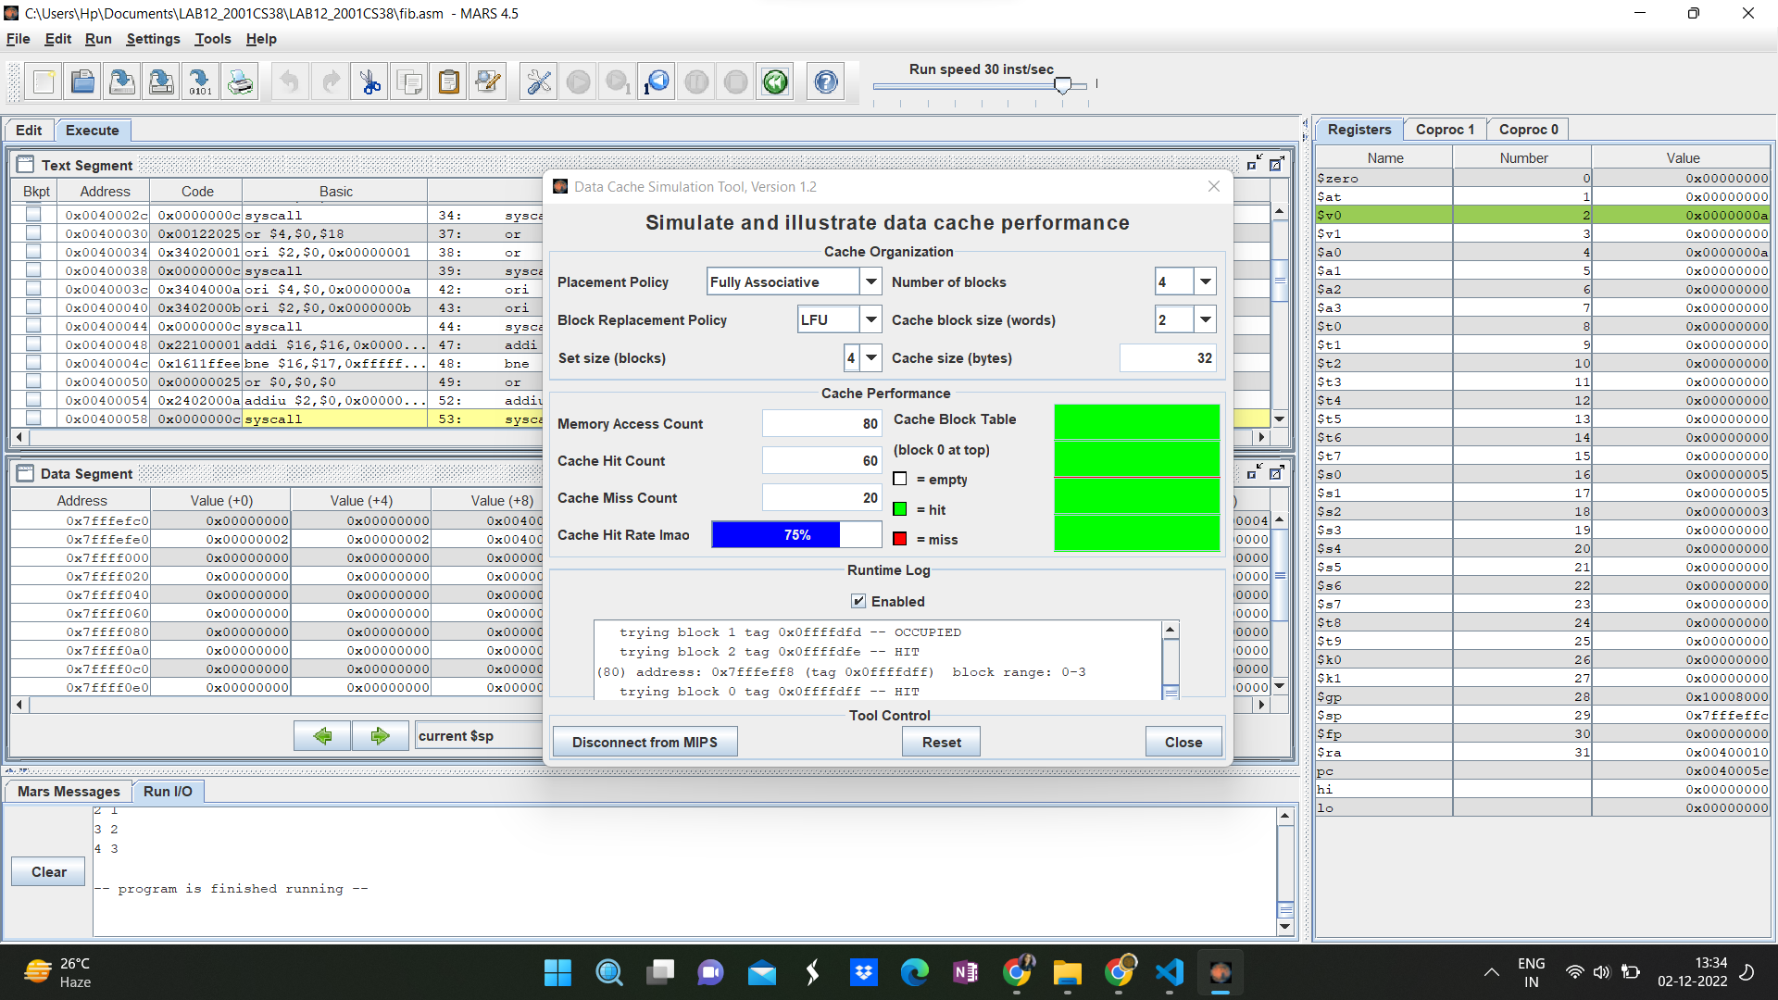
FIBONACCI, LFU REPLACEMENT POLICY, CACHE HIT RATE = 75%

Slide 20

FIBONACCI, LRU REPLACEMENT POLICY, CACHE HIT RATE = 84%

Slide 21

FIBONACCI, LRU 2 REPLACEMENT POLICY, CACHE HIT RATE = 84%

Slide 22
ANALYSIS :
FIFO and LFU replacement policies have the worst performance. They have the least cache hit rate. And for FIFO as it is observed, the cache hit rate decreases when the number of blocks is increased. It can be attributed to the fact that FIFO sometimes replaces an active block and brings it back after two or three memory accesses. This takes many times, because it writes in cache and brings it back to main memory in two steps.
LRU and LRU 2 are the best performers in this case, LRU is the better algorithm to implement in these conditions. The cache hit rate for LRU is even greater than Random.
Random has average performance.
POLICY | HIT RATE
RANDOM | 80%
FIFO | 75%
LFU | 75%
LRU | 84%
LRU - 2 | 84%

Slide 23
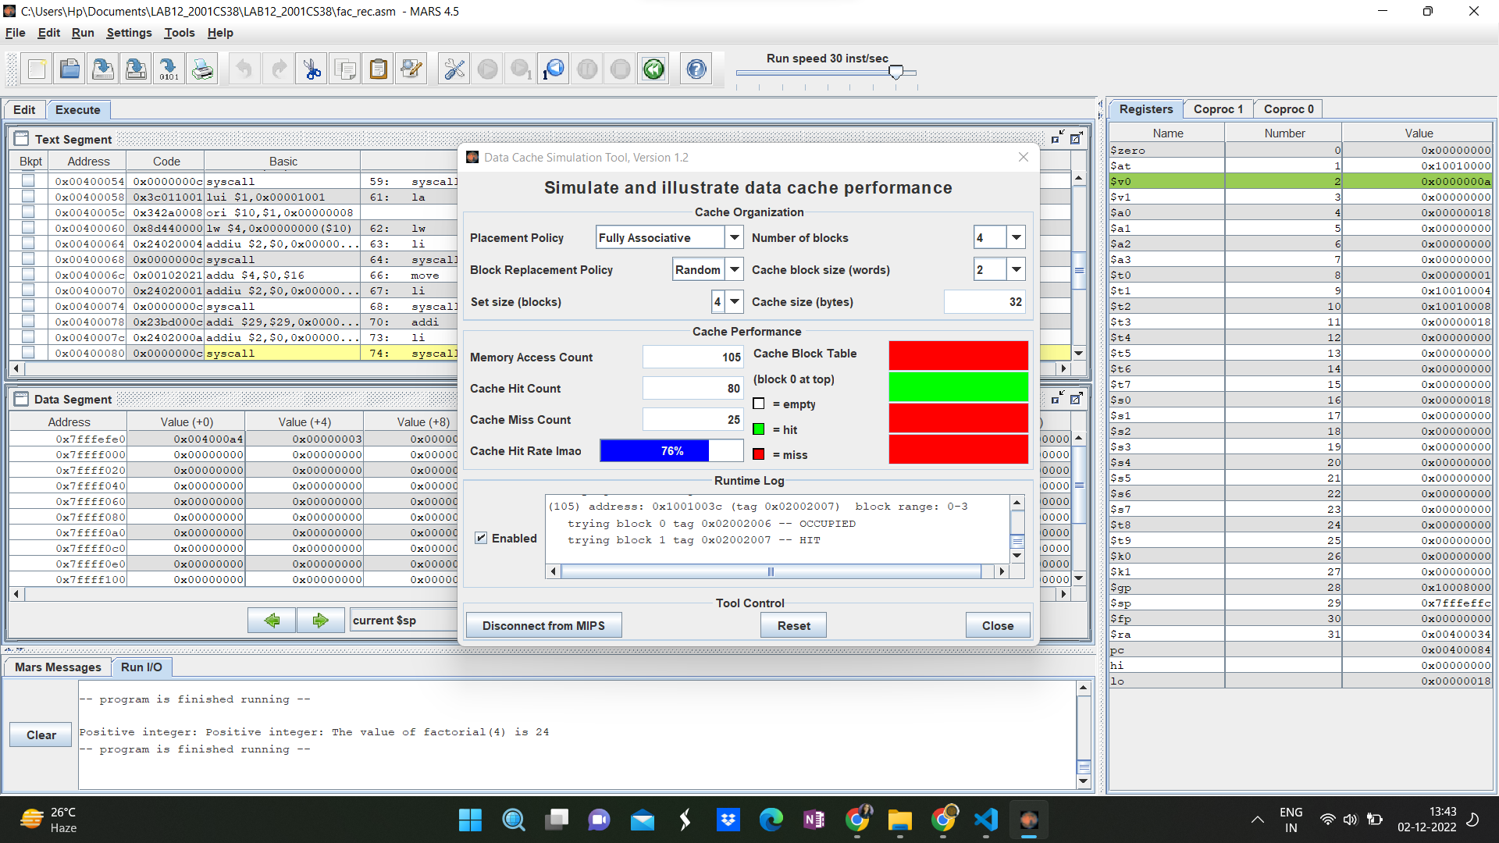
FACTORIAL, RANDOM REPLACEMENT POLICY, CACHE HIT RATE = 76%

Slide 24
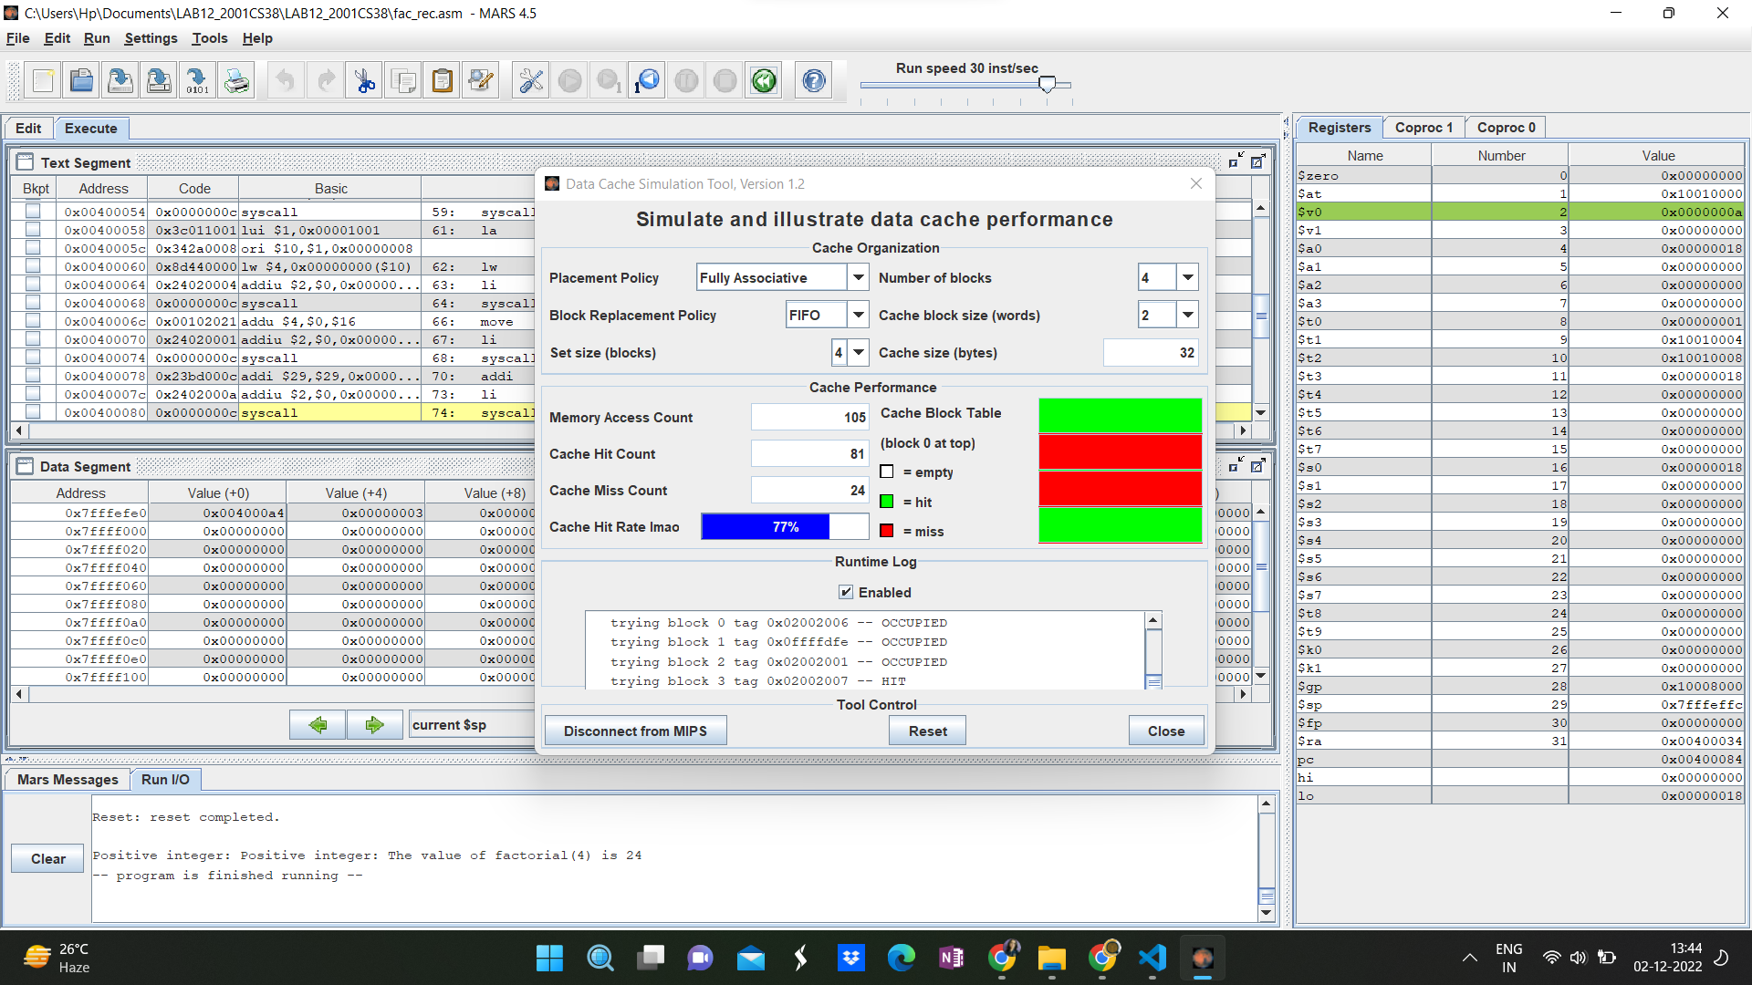
FACTORIAL, FIFO REPLACEMENT POLICY, CACHE HIT RATE = 77%

Slide 25
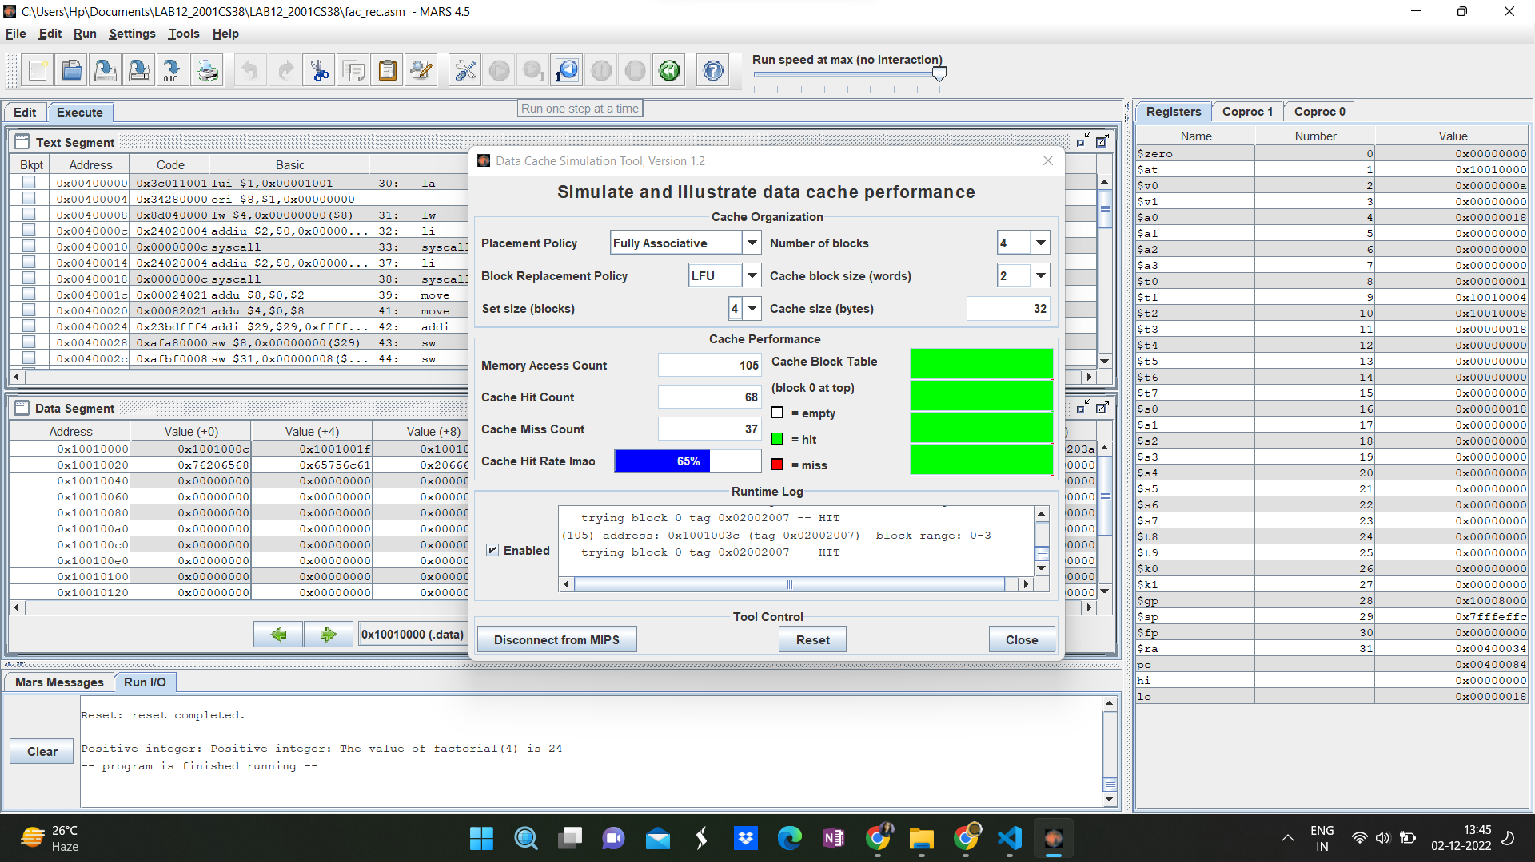
FACTORIAL, LFU REPLACEMENT POLICY, CACHE HIT RATE = 65%

Slide 26
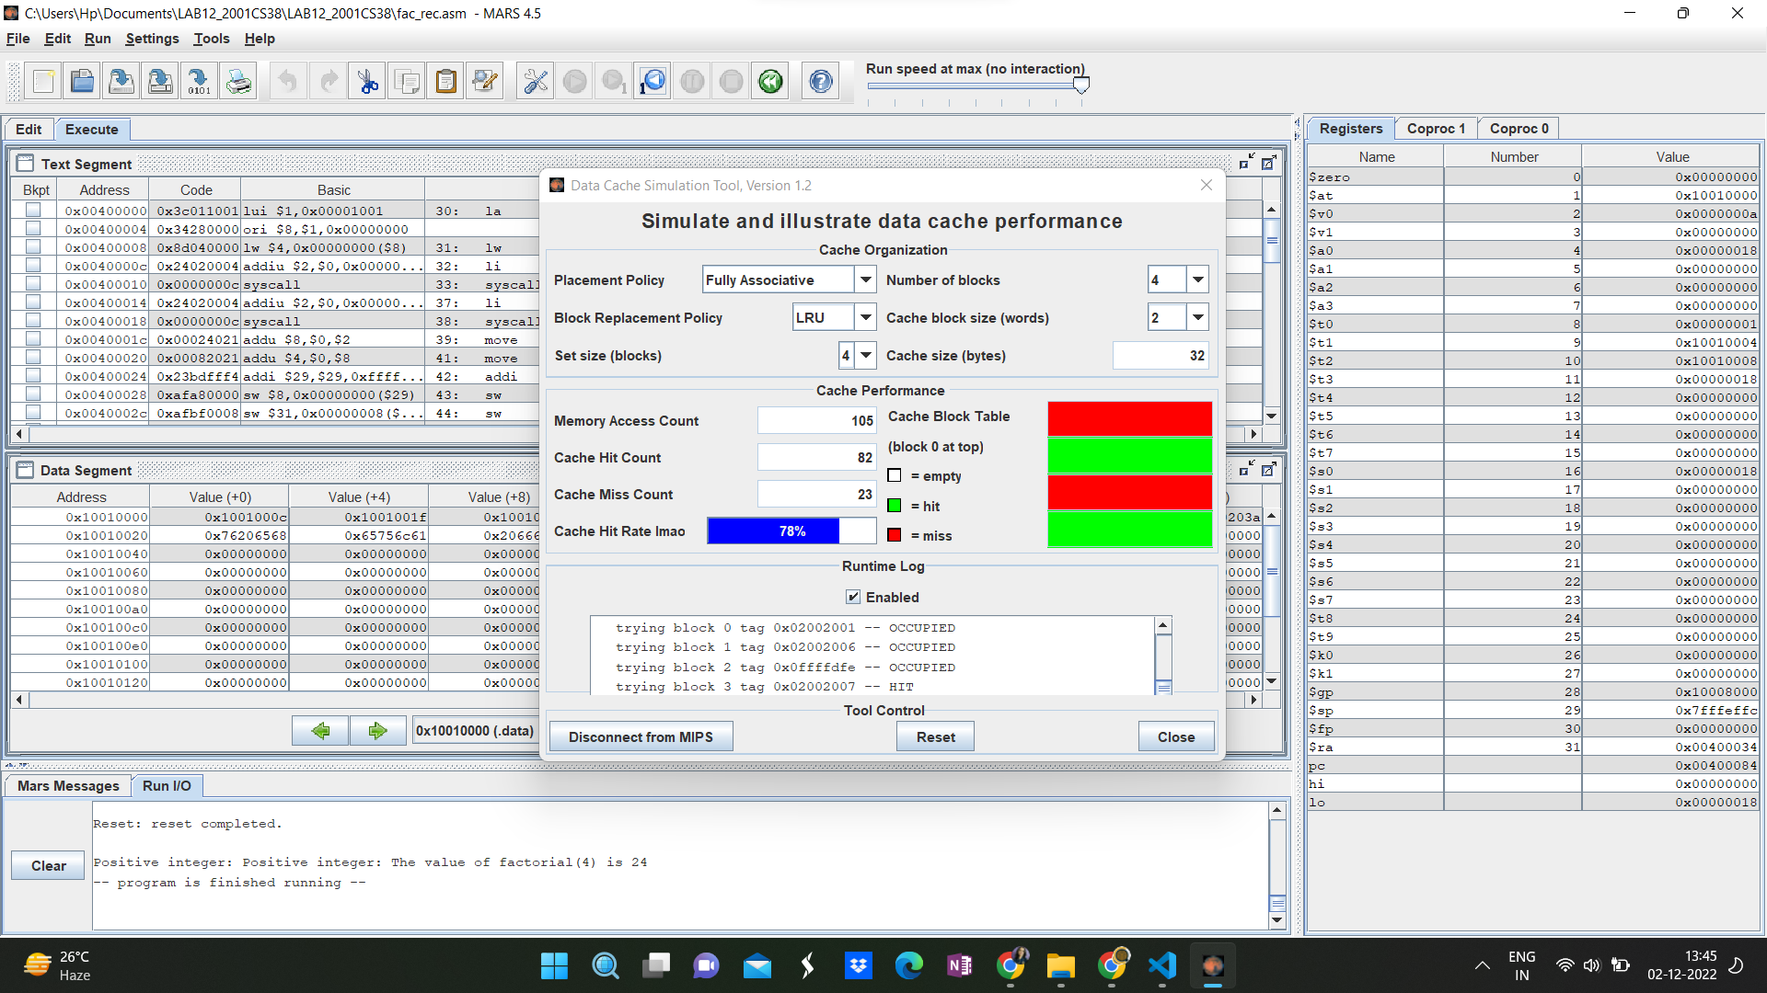
FACTORIAL, LRU REPLACEMENT POLICY, CACHE HIT RATE = 74%

Slide 27
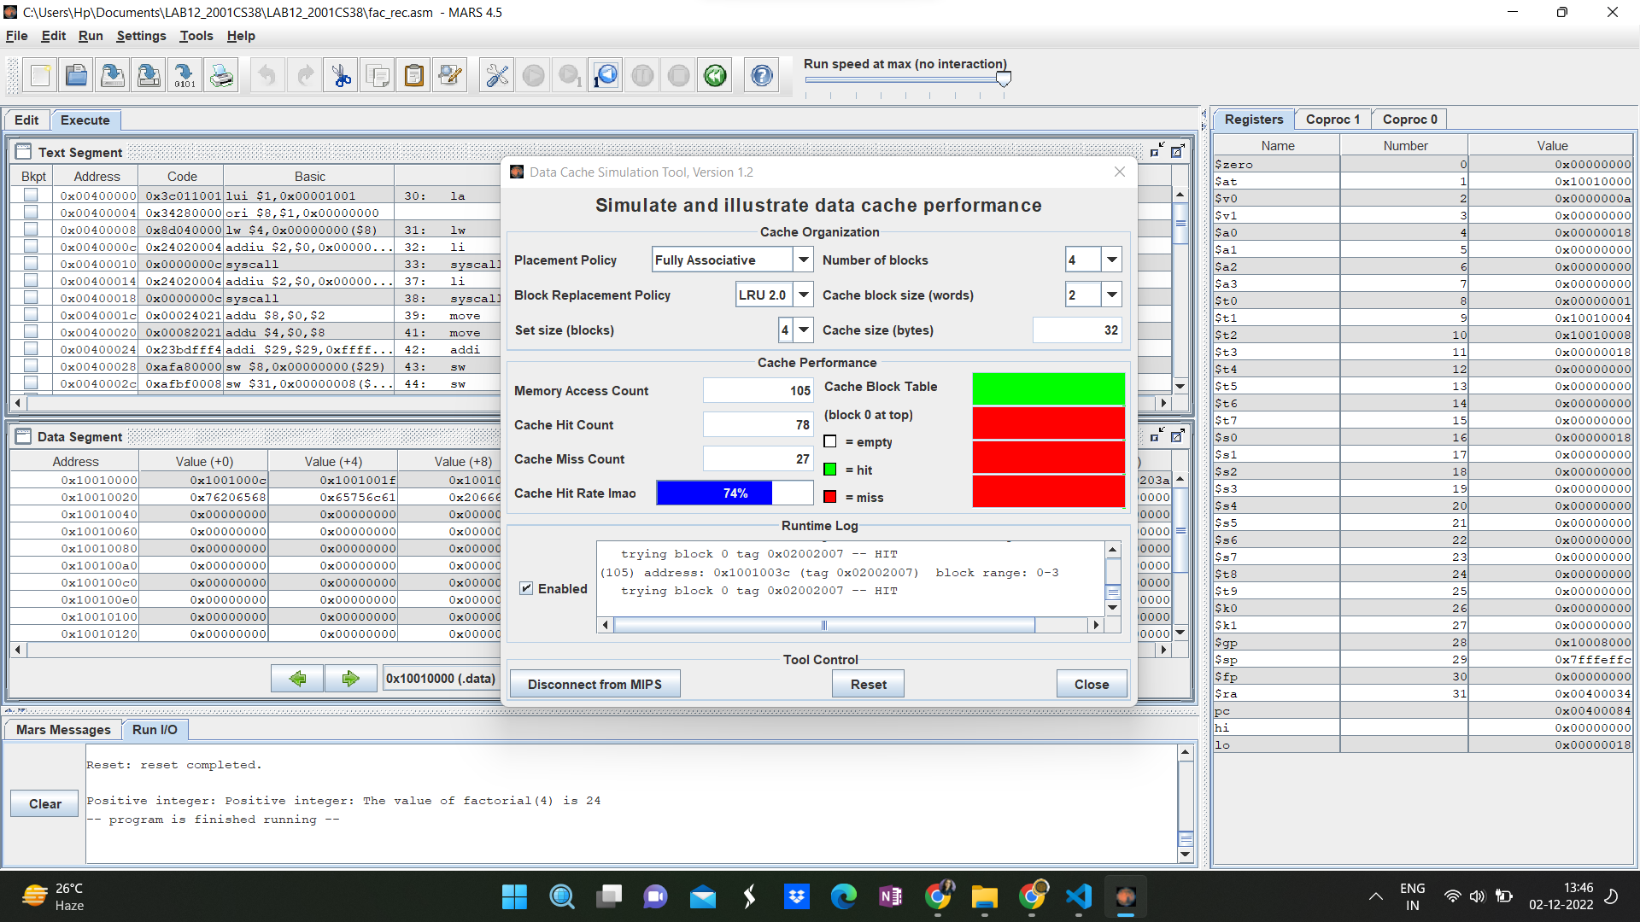
FACTORIAL, LRU 2 REPLACEMENT POLICY, CACHE HIT RATE = 74%

Slide 28
ANALYSIS :
As observed, LFU has the least Cache Hit rate out of all Replacement Policies. In the above program, the smaller numbers will be used more times as compared to the larger numbers. Thus, in case of a full set, the LFU replacement policy will replace the block containing the larger numbers (of the numbers stored in the cache). But these numbers will also be required further in computation. This will cause an increase in Miss Rate.
In this case, FIFO performs the best and has a Cache HIt Rate greater than the Random Cache Hit Rate. FIFO stores the number nearest to the argument in cache and thus reduces miss rate.
LRU and LRU 2 have the average performance in this case, better than Random as they replace the most recent and second most recently used cache blocks respectively.
POLICY | HIT RATE
RANDOM | 76%
FIFO | 77%
LFU | 65%
LRU | 74%
LRU - 2 | 74%

Slide 29
CONCLUSION :
As we increase the cache size, the miss rate increases.
LRU replacement policy is the best as compare to the all other replacement policies However, it’s implementation is not very easy.
FIFO is very easy to implement but not very efficient as it might replace active blocks.
LFU is not an efficient policy.
LRU - 2 is also not commonly used and for simpler algorithms like the once used, imitate the LRU policy. However, their efficiency increases with the increase in cache size.
Random algorithm has the best average case performance and its performance varies for the same algorithm.
POLICY | REMARKS
RANDOM
FIFO | Might replace important blocks
LFU | Not Efficient
LRU | Excellent, but difficult to implement, as it requires substantial hardware assistance
LRU - 2 | Efficiency increases as the size of cache increases

